Slide 1
Session Layer

Slide 2
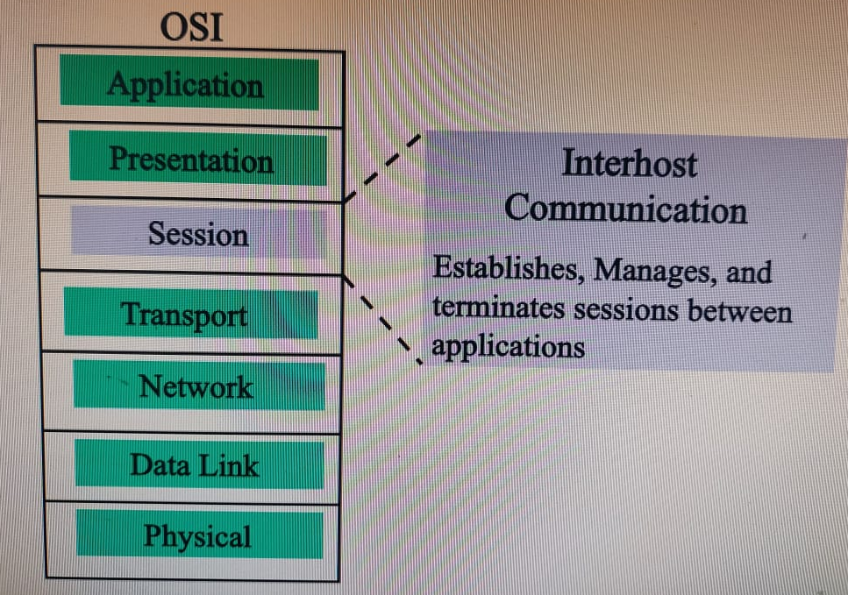

Slide 3
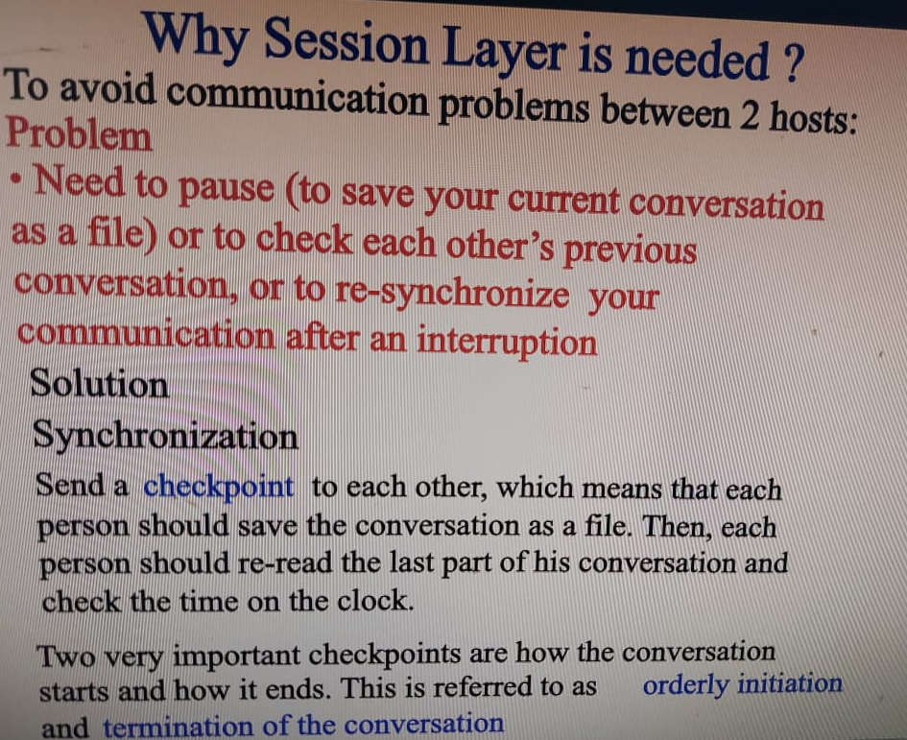

Slide 4
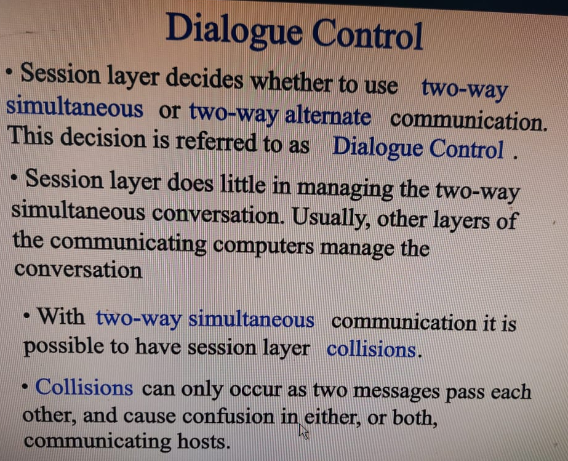

Slide 5
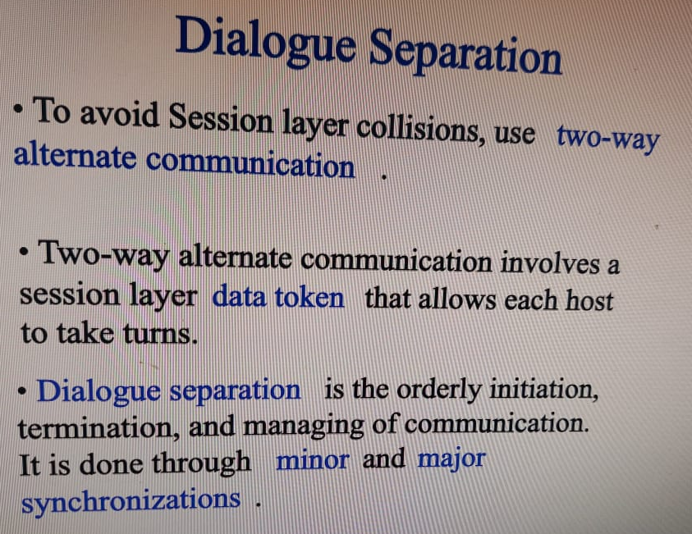

Slide 6
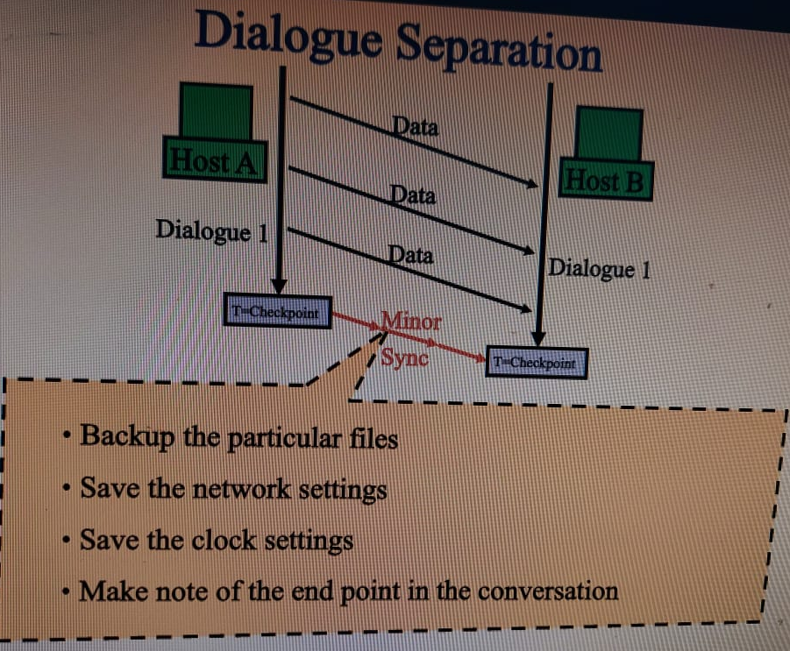

Slide 7
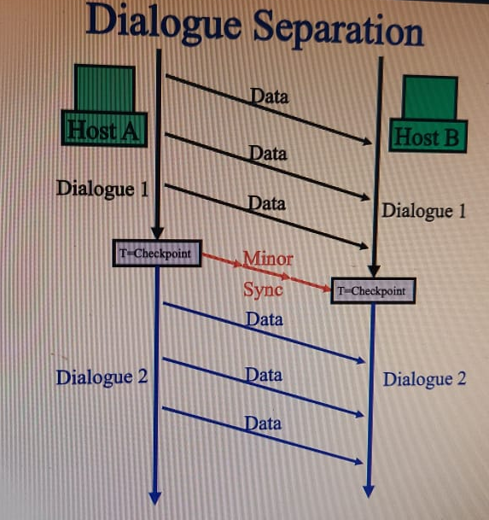

Slide 8
RPC
1984: Birrell & Nelson
Mechanism to call procedures on other machines
Goal: it should appear to the programmer that a normal call is taking place

Slide 9
Compiler generates from API stubs for a procedure on the client and server
Client stub
Marshals arguments into machine-independent format
Sends request to server
Waits for response
Unmarshals result and returns to caller
Server stub
Unmarshals arguments and builds stack frame
Calls procedure
Server stub marshals results and sends reply

Slide 10
Stub functions
1. Client calls stub (params on stack)
client functions
server functions
client stub
server stub (skeleton)
network routines
network routines
client
server

Slide 11
Stub functions
2. Stub marshals params to net message
client functions
server functions
client stub
server stub (skeleton)
network routines
network routines
client
server

Slide 12
Stub functions
3. Network message sent to server
client functions
server functions
client stub
server stub (skeleton)
network routines
network routines
client
server

Slide 13
Stub functions
4. Receive message: send to stub
client functions
server functions
client stub
server stub (skeleton)
network routines
network routines
client
server

Slide 14
Stub functions
5. Unmarshal parameters, call server func
client functions
server functions
client stub
server stub (skeleton)
network routines
network routines
client
server

Slide 15
Stub functions
6. Return from server function
client functions
server functions
client stub
server stub (skeleton)
network routines
network routines
client
server

Slide 16
Stub functions
7. Marshal return value and send message
client functions
server functions
client stub
server stub (skeleton)
network routines
network routines
client
server

Slide 17
Stub functions
8. Transfer message over network
client functions
server functions
client stub
server stub (skeleton)
network routines
network routines
client
server

Slide 18
Stub functions
9. Receive message: direct to stub
client functions
server functions
client stub
server stub (skeleton)
network routines
network routines
client
server

Slide 19
Stub functions
10. Unmarshal return, return to client code
client functions
server functions
client stub
server stub (skeleton)
network routines
network routines
client
server

